Slide 1
Software Process Maturity
Viswanathan Hariharan

Slide 2
Contents
Goal of software process
Characteristics of effective software process
Process maturity levels

Slide 3
Goal of Software Process
To produce software that meets users needs
To produce software according to plan
To improve organization’s capability to produce better products
Page <number>

Slide 4
Characteristics of a truly effective software process
It must result in a product that meets users expectations
  Functionality – In a banking system the functions would be Opening a bank account, Deposit and Withdraw from the account, etc.
  Performance – Response time, Performance under high volumes of transactions
  Reliability –Tolerant to wrong user inputs, withstand high volumes and not crashing, withstand component failures such as server failure, network failure, disk crash, etc.
  Ease of use – of application by end users, ease of administration such as configuration, backup, installation, etc.
  Inter-operability – Ability to work with other systems. Example: SBI Retail Banking system should be able to inter-operate with systems of other banks, RBI, etc. Indigo’s airline reservation system should be able to inter-operate with MakeMyTrip.com
  Extensibility – Ability to extend the functions within the boarder purpose of the system. For example if a banking system supports Savings account and Fixed deposit, we should be able to add other types of accounts such as Recurring deposit account. However, adding insurance domain functions may not be considered as extensions.
  Etc.
Page <number>

Slide 5
Characteristics of a truly effective software process
Process must be predictable in
  Quality (defects)
  Schedule
  Effort & cost
Predictable means ability to deliver within a certain range
  For example
  If we order a Pizza from Pizza Hut, we can be fairly certain that it will be delivered in 30 min +/- 5 minutes
So in case of software
  The software projects of an organization should consistently deliver software at a certain level of quality, schedule, effort and cost and these should not vary beyond a certain range
Page <number>

Slide 6
How to improve capability of the organization to produce better products?
Improving capability means
  Improving the quality of products
  Improving productivity – absolute as well as variation
  Improving timeliness – absolute as well as variation
The software process should aid the organization in improving the quality over a period of time
  For example from an average defect of 1 defect for 1000 LoC to 0.5 defects
  From 8 hours per Function point to 6 hours per FP
  From +/- 10% variation in schedule to +/- 5% variation in schedule over 3 years
Such improvements require deeper analysis of the process steps and process parameters

Slide 7

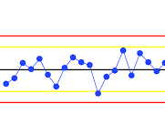
Improvement in Quality
Reduction in defects
Reduction in variation
Time

Slide 8
How to create a truly effective software process?
Treat the entire software development task as a process that can be measured & improved
Let us look at an example of a process: Car accident claim process
Owner Customer Rep Adjuster Adjuster Officer Clerk
Report accident
Assign adjuster
Schedule visit
Visit &
Estimate damage
Approve amount
Send cheque
1 hr 2 hr 1 day 1 day 1 day 1 day
50% visits on time 70% estimates are OK
End to end duration: 5 days
Page <number>

Slide 9
Here is an improved process based on analysis
Issues: Too many hand-offs, Errors in estimation, Lack of empowerment
Owner Customer Rep Adjuster
Call
1-800-….
Find nearest adjuster &
Schedule visit
Visit,
Estimate & Issue cheque
15 min 30 min 4 hours
80% visits on time 95% estimates are OK
End to end duration: 5 hours

Slide 10
Comparing the old & new processes
Old process
Owner Customer Rep Adjuster Adjuster Officer Clerk
Report accident
Assign adjuster
Schedule visit
Visit &
Estimate damage
Approve amount
Send cheque
End to end duration: 5 days
New process
Owner Customer Rep Adjuster
Call
1-800-….
Find nearest adjuster &
Schedule visit
Visit,
Estimate & Issue cheque
End to end duration: 5 hours

Slide 11
Similarly we can look at software development process & understand how it is performing
50% defects
30% defects
20% defects
Understand requirement
Analyze & Design
Develop
Test
Deploy
1 m 2 m 3 m 1 m
2 p 2 p 5 p 3 p
100 defects
Based on the analysis of the process performance, we can re-design the process and improve it

Slide 12
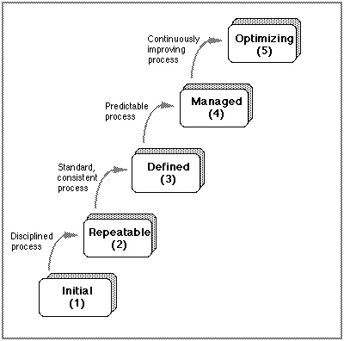
Process Maturity Levels
As an organization keeps improving its software process, it goes through different levels of maturity
Org. has foundation for continuous improvement
Org. has initiated comprehensive process measurement & analysis
Defined process with rigorous project management of cost, schedule & changes. Process may vary by type of project
Some discipline – all projects do planning, monitoring, reviews - but not in the same way
Chaotic - No control, unrealistic schedules, inadequate resources, frequent crisis
Page <number>

Slide 13
Initial process (Level 1)
In this level, the situation is chaotic with no control
We can take the following initial set of actions to move to next level:
Institute basic controls such as
Project management,
Management oversight,
Quality assurance,
Requirement change control
Page <number>

Slide 14
Initial process (Level 1)
Basic Project management consists of
  Create a project plan
  Effort estimation,
  Scheduling,
  Monitoring the progress and
  Taking corrective actions
Management oversight consists of
  Reviewing & approving all major development plans,
  Review of process compliance,
  Product quality and productivity
Institute a Quality Assurance group to monitor compliance to plans & processes
  To be effective the SQA group should report directly to senior management
Institute change control to maintain reasonable stability of requirement
  Many changes can be deferred to subsequent releases
  If not controlled, no quality plan can be effective
Page <number>

Slide 15
Repeatable process (Level 2)
Because of the basic steps & controls instituted, the organization has some control over its plans & commitments
This strength stems from doing similar work for a long time
  For example because of developing many applications in C++, the organization knows how to plan for C++ projects, what is expected # of defects, etc.
When you do similar projects for a long time,
  We know what process steps are essential for delivering reasonable quality of deliverables
  We understand what works, what does not, how long does it take, etc.
Page <number>

Slide 16
Repeatable process (Level 2)
The major risks at this level are when
  A new tool or method is introduced, say a new Development environment such as Eclipse, or a new tool to perform stress test such as Load Runner
  A new kind of product is to be developed. Let us say we have been developing Banking applications and we need to develop a Real time software
  A major org. change happens where new people are inducted into the org. and they do not follow the old processes due to lack of knowledge about it
Page <number>

Slide 17
Repeatable process …
Key actions to advance to next level are:
Establish a process group to focus on process improvements
Establish software development process architecture
Introduce a family of Software Engineering methods & technologies
Page <number>

Slide 18
Repeatable process …
Key actions to advance to next level are:
Establish a process group to focus on process improvements. This will include activities such as:
  Define the development process – Waterfall, Agile, RUP – and when to use what
  Define methods & tools needed for different process steps such as requirement gathering, estimation, tracking defects, etc.
  Advise projects on process, methods, tools and technology
  Conduct quality management reviews of process performance
    Process performance – What is the productivity at each process step such as design, code, test, etc., how many defects were found at each step, how much was the rework effort, what is the variation of process performance across projects, etc.
Page <number>

Slide 19
Repeatable process …
Key actions to advance to next level are…:
Establish software development process architecture
  Product architecture describes the software components & their interaction
  Process architecture describes process components such as technical activities & management activities and their inter-relationships
  The process architecture can be defined at different levels of detail such as
    Universal level – this is defined at a very high level for example a waterfall model or Unified process model
    Worldly level – this defines the sequence of tasks, who does what & when, what are the pre-requisites for a task, etc.
    Atomic level – this is at a very low level specifying coding standards, documentation standards
Page <number>

Slide 20
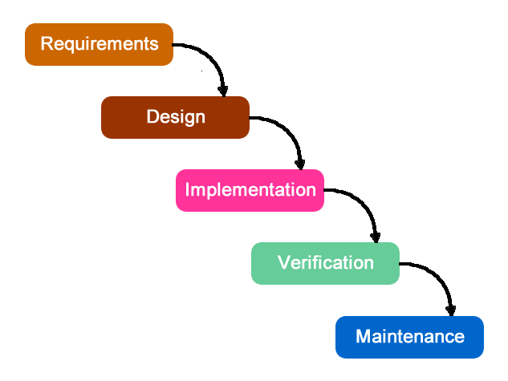
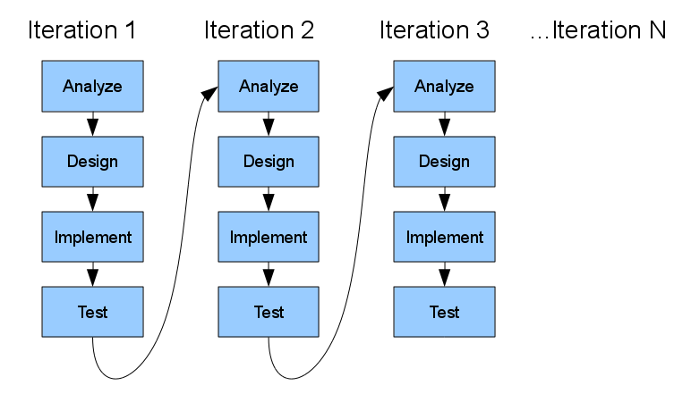
High level model
Waterfall model
Unified Process Model
Good when requirements are clear & frozen
Good when requirements are unclear & incomplete

Slide 21
Repeatable process …
Key actions to advance to next level are…:
  The description of technical & management activities include
    Functional description of activities to be performed.
    Prerequisites to perform an activity
    Verification procedure
    Task completion criteria
    Etc.
Page <number>

Slide 22
Example of process step description
Pre-requisites
    For ex. Latest version of s/w should be moved to UAT environment before UAT can start
Functional description
For example, Execute UAT test cases, record defects in tool, assign defects to engineers, fix the defects,….
Completion criteria
For example UAT is complete when there are Zero major defects and less that 4 minor defects.
Verification procedure
For example, End users will test the software based on UAT plan

Slide 23
Repeatable process…
Key actions to advance to next level are…:
Introduce a family of Software Engineering methods & technologies
  Methods are specific ways of doing a process step
    For example Estimation can be made using WBS method or FP method
    Design can be done using object oriented method or functional decomposition method,
    Coding can be done using the stepwise refinement method (Wirth) or through Test Driven development (TDD) method
  Technology can be a language or a tool that is used while using a method
    For example, the programs could be developed in Java or Python,
    Bugs can be tracked in a tool called Bugzilla or some other tool
Page <number>

Slide 24
Repeatable process…
Methods & Technologies need to be defined for the following aspects:
  Design & code inspection
  Design method
  Testing methods
  Library control system (to store project artefacts)
  Prototyping
  Languages

Slide 25
Defined process (Level 3)
At this level, the foundations have been established for examining the process and deciding how to improve it
However, there is little data to indicate how effective the process is
Key steps to move to the next level are:
  Establish a minimum set of process measurements to identify quality and cost parameters of each step
    Ex. Number of defects found at a process step
    Number of defects by defect category (such as major, minor)
    Size, Effort & Cost of performing the process step
    Effort for rework & fixing defects
    # of requirement changes requested at each step
Page <number>

Slide 26
Defined process (Level 3)
Key steps to move to the next level are (Continued…):
  Establish a process database to facilitate process quality analysis and productivity analysis,
    Example of Process quality is defect density at each phase
    Example of Process quality analysis is comparing defect density with that of similar projects
    Defect density can be measured in terms of # of defects per 1000 LoC or # of defects per person-month effort
    Example of Productivity is effort per FP for each phase of the project such as design, coding, testing.
    Examples of Productivity analysis is comparing productivity across similar projects and looking at the trend of productivity over time – increasing, decreasing, etc.
Page <number>

Slide 27
Defined process (Level 3)
Key steps to move to the next level are (Continued…):
  Monitor quality of data before it enters the database
    Ex. While entering effort for coding, do people exclude meeting time,
    While entering LoC do people exclude the comment lines, etc.
    While entering defect data, do people accurately classify the defect as major, minor, etc.
  Assess relative quality of each product and inform management where quality targets are not being met
    Let us say the quality target is to have less than 10 defects for 1000 lines of code during Integration testing, then compare the actual figure with this target and the extent of deviation from the target and report to management
    There can be other targets such as productivity target (example - effort to develop 1000 LoC)
Page <number>

Slide 28
Managed process (Level 4)
Substantial quality improvements have been made, by following the defined processes, SQA reviews, and management reviews
Key challenges now are cost of gathering data, because there an enormous number of potentially valuable measures
Page <number>

Slide 29
Managed process (Level 4)
Key actions that can be taken at this level are:
  Precisely define each piece of data, ex.
    LoC: Does this include comments, Does it include changed code only or LoC of the entire function being changed
    Effort: Does it include review & documentation effort also
  Do not use process data to judge individuals. Else reliability of data will deteriorate
  Support automatic gathering of data, wherever possible
    Ex. LoC, Cyclomatic complexity, code coverage by test cases
  Use process data to analyse & modify processes to prevent problems & improve efficiency
    Ex. If defect density is high during UAT and less in Design review, could we tighten the Design review in subsequent project so as to reduce defects in UAT
Page <number>

Slide 30
Optimizing process (Level 5)
Process optimization goes on at all levels of process maturity
Up to level 4, optimization mainly happens in product quality
In level 5, optimization happens in process. Ex.
  Many types of errors can be identified and fixed far more economically by design or code inspections than by testing.
  So rely less on testing as the primary way to find & fix bugs
  Some kinds of errors are either uneconomical to detect or almost impossible to detect without a machine, ex.
    Spelling errors, syntax errors, interface errors, performance, human factors
    So testing is definitely needed
Data gives new perspectives, such as
  To reduce cost of removing defects, focus on inspection
  Analysis of defects can point to fundamental errors in requirement gathering and / or design
Page <number>

Slide 31
Need for Optimizing process
Software touches every facet of life
Software is being used in critical applications such as missile, atomic energy, health care (pace makers, radiation, laser), aircraft control, mobile communication, factory control, etc.
Page <number>

Slide 32
Need for Optimizing process
Software systems are becoming large and complex
  Large number of sub-systems, products
  Complex due to use of different technologies such as communication technologies (Bluetooth, WiFi), data mining, distributed computing, storage technologies, mobile computing, etc.
  Complex due to multiple software components such as front-end, middleware, business objects, databases which are further distributed across servers
  Complex due to complex logic to make the system more & more intelligent
Unless we dramatically reduce the error rates, larger size of code will mean increased risk of error
The optimizing process provides a foundation for significant advances in software quality and simultaneous improvement in productivity
Page <number>

Slide 33
Homework
What is the typical size & complexity of software in your organization?
Look at the software process in your organization. What do you think is the level of process maturity of the software development process?
Page <number>

Slide 34
Appendix
Page <number>

